Slide 1
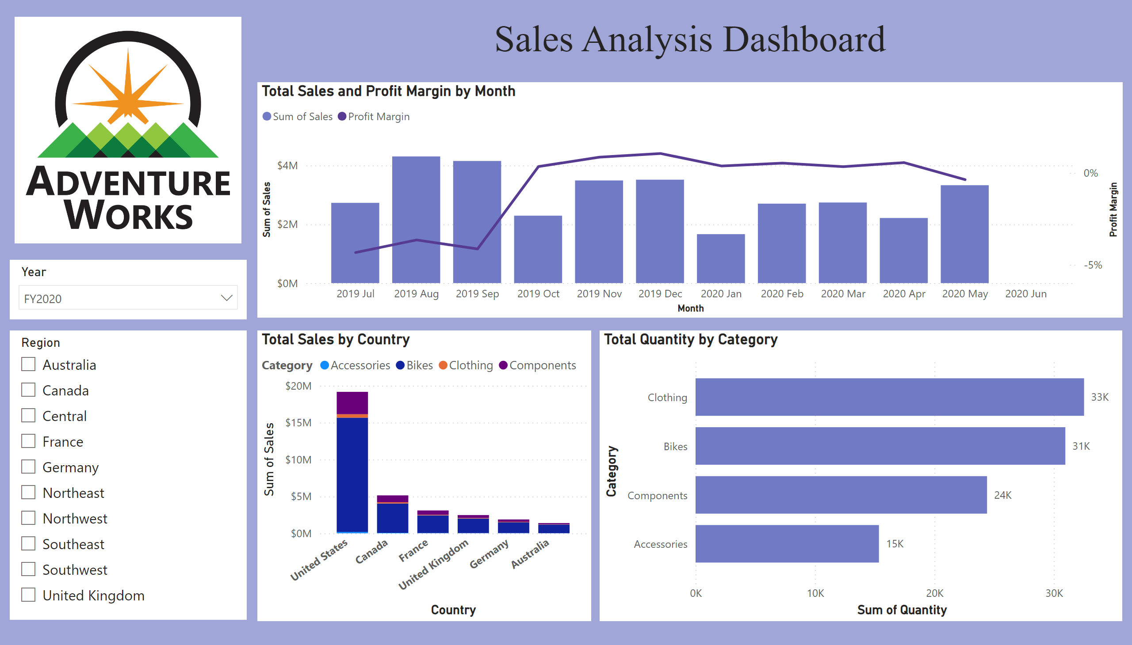
Overview
Notes:
image
No alt text provided
slicer
No alt text provided
slicer
No alt text provided
Total Sales and Profit Margin by Month
No alt text provided
Total Sales by Country
No alt text provided
Total Quantity by Category
No alt text provided
textbox
No alt text provided

Slide 2
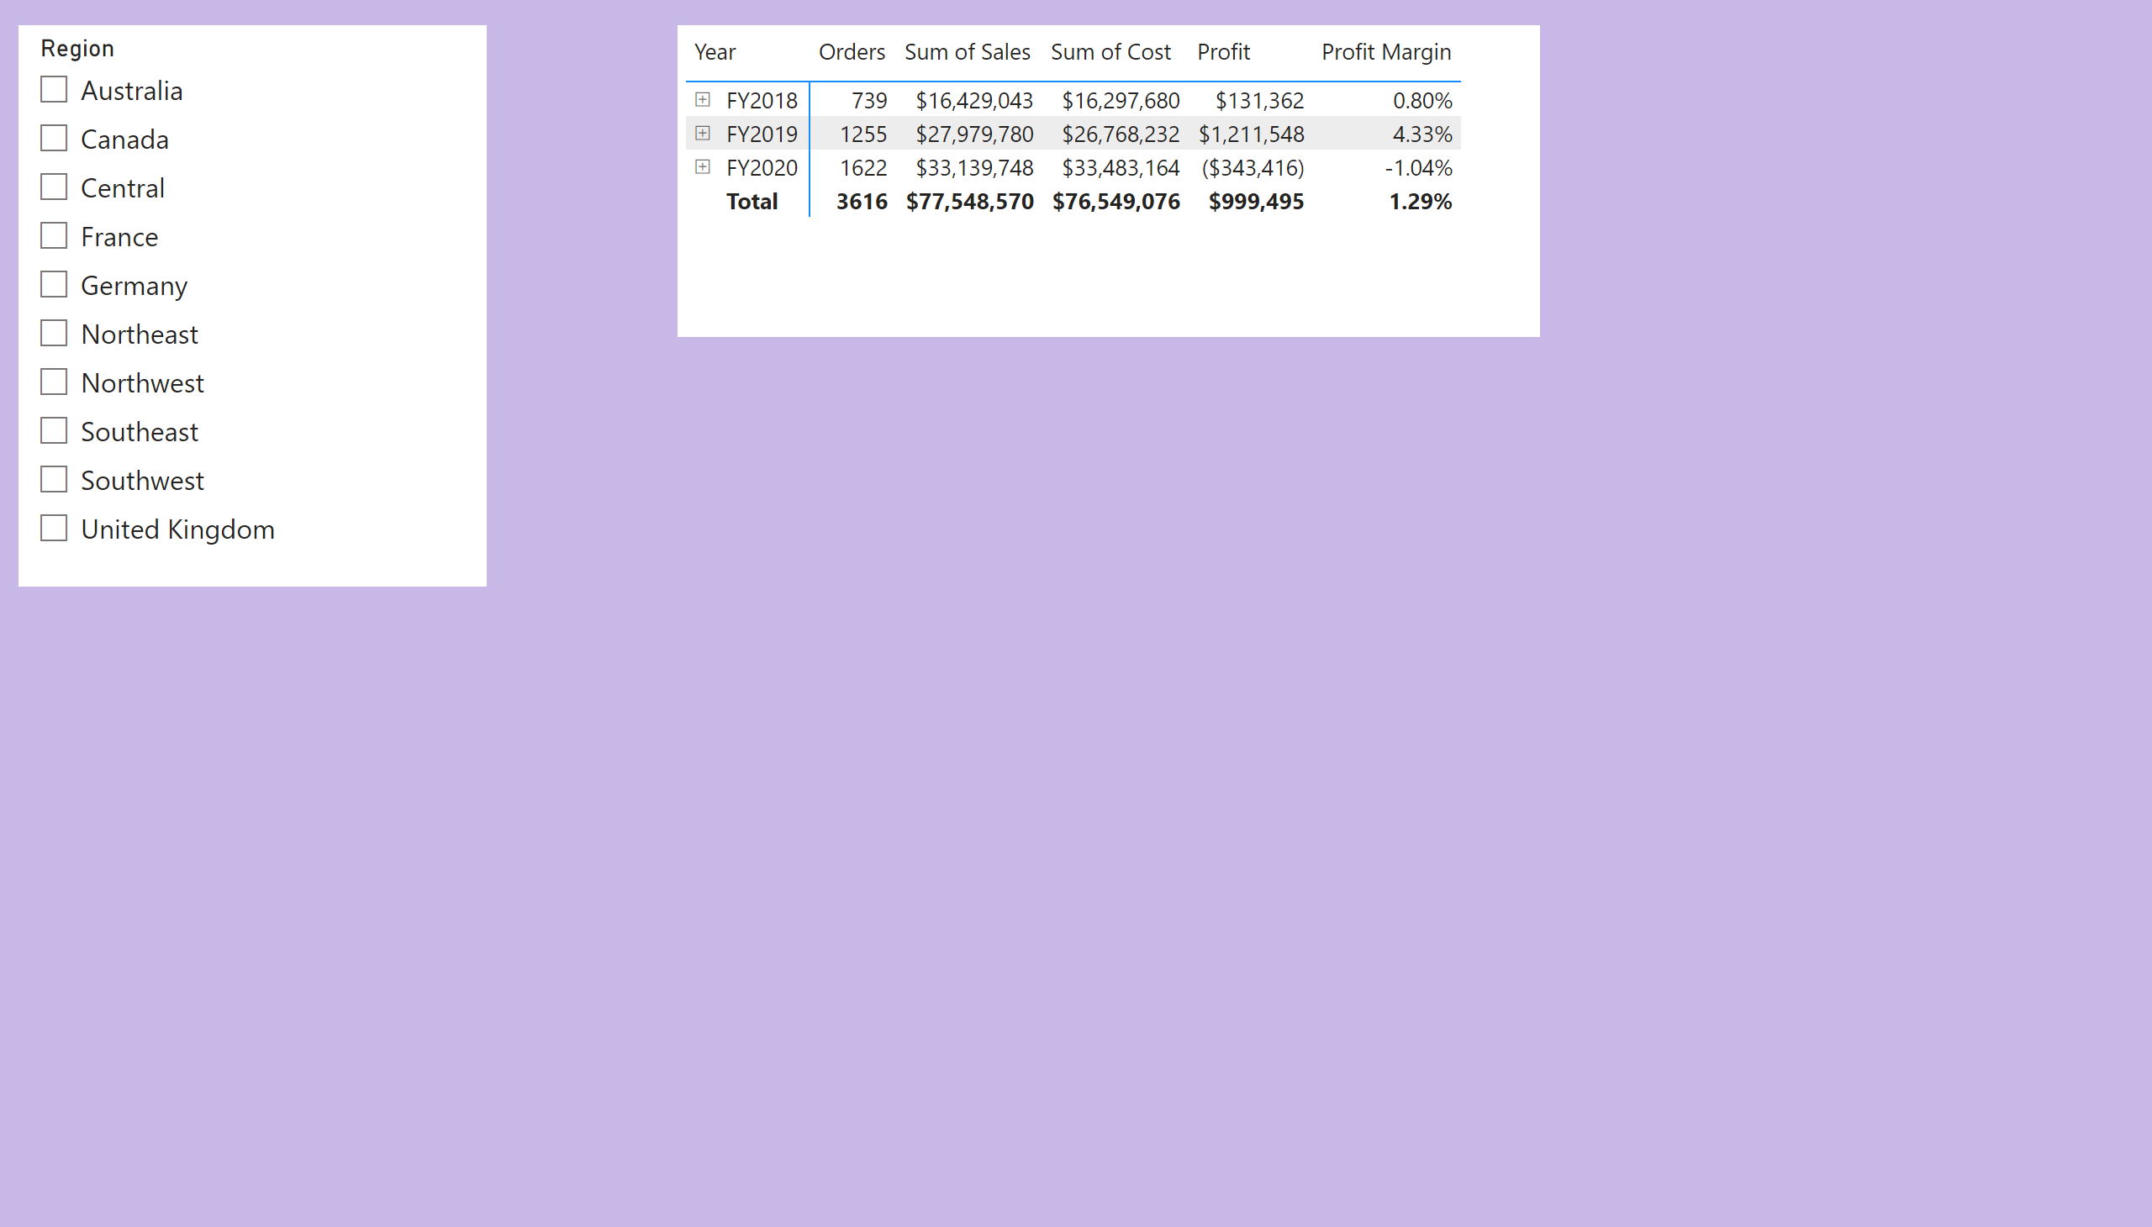
Profit
Notes:
slicer
No alt text provided
pivotTable
No alt text provided

Slide 3
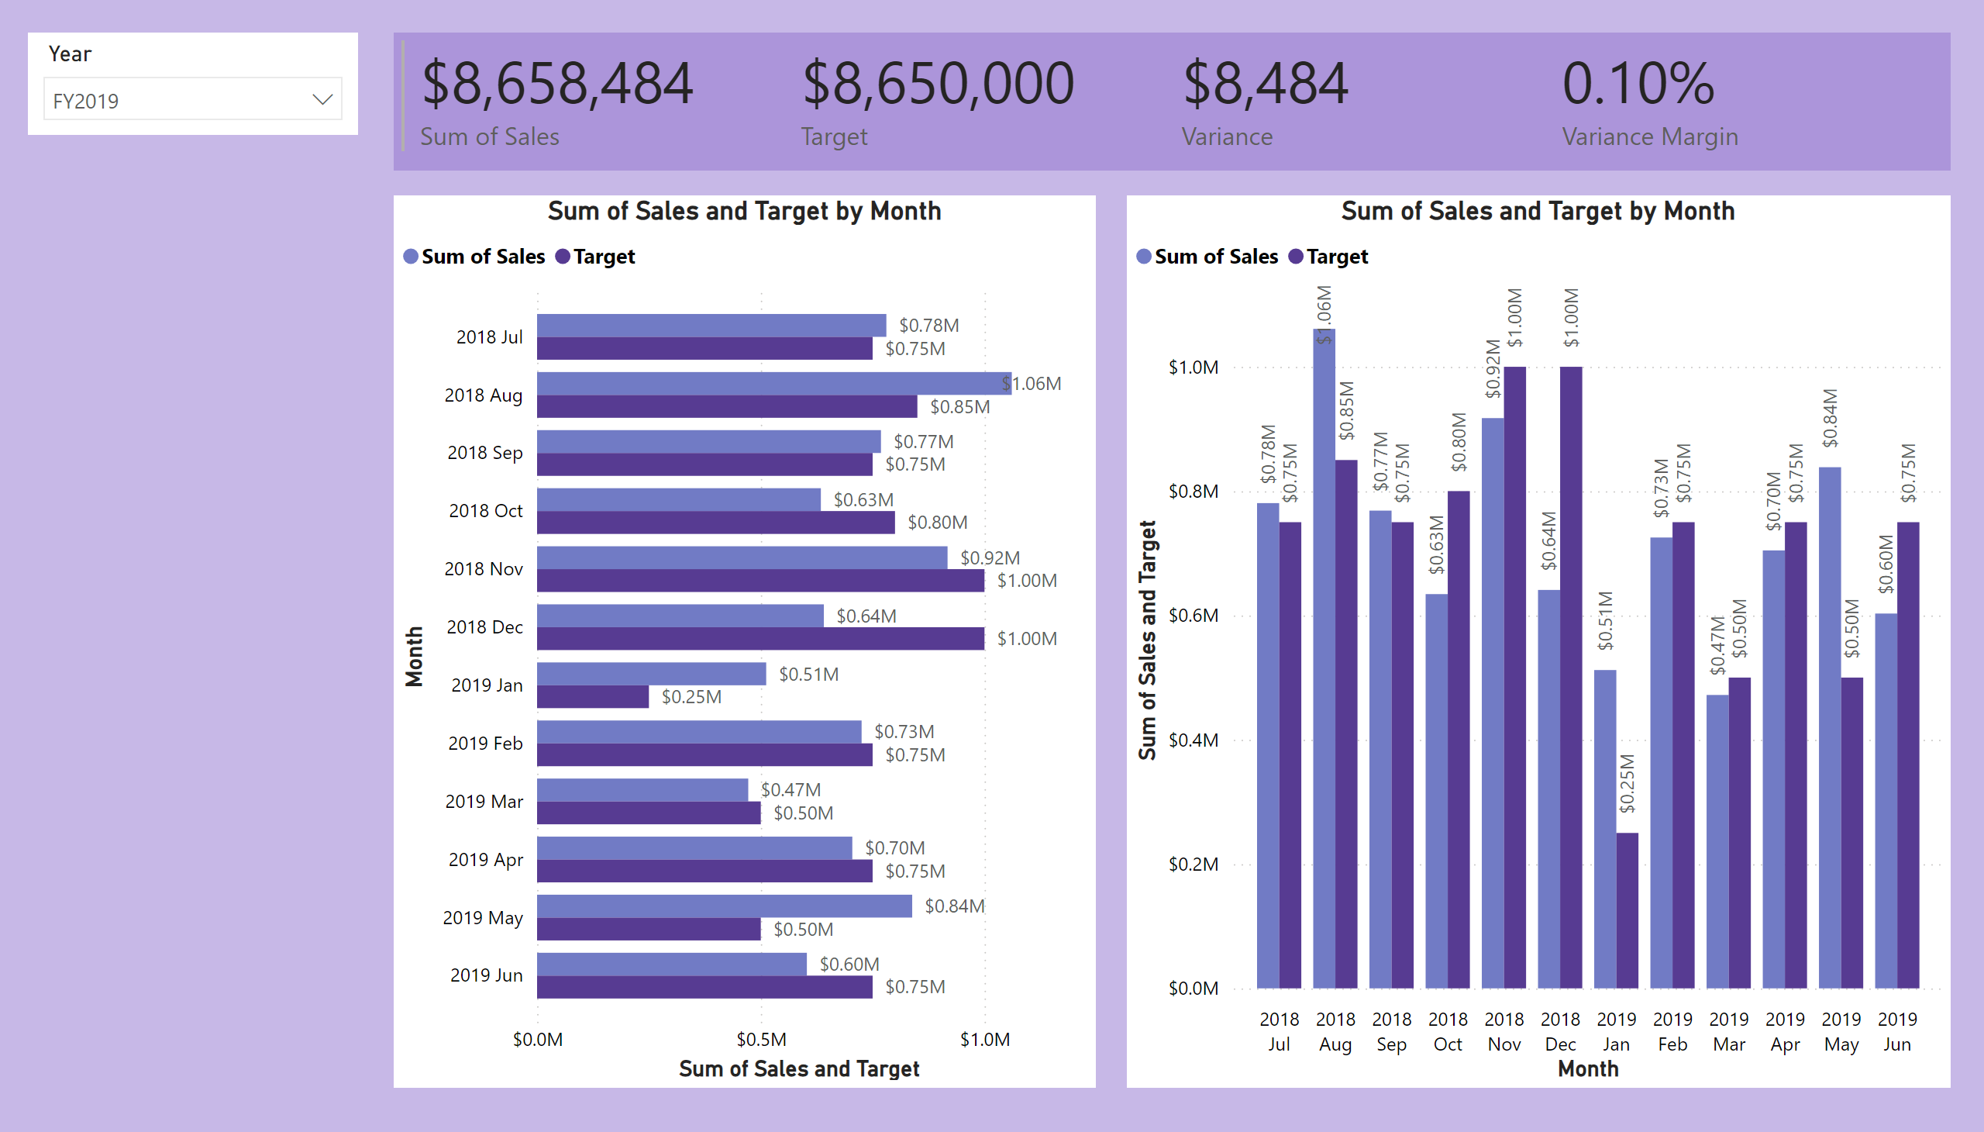
My Performance
Notes:
slicer
No alt text provided
multiRowCard
No alt text provided
clusteredBarChart
No alt text provided
clusteredColumnChart
No alt text provided

